Slide 1


A Project Submitted To
Submitted In Partial Fulfillment Of The Requirements For The Degree Of
“Master Of Computer Application”
Submitted By
Abhi Sheth
(Enrollment Number : 220441020)
Under The Esteemed Guidance Of
“Mr. Ezaz Shaikh ”
Faculty Of MCA
(Noble University)

Slide 2
The Project Title Is “Find Job” . This Project Is Based On Job Management System. In This Project User Can Login , Search Job , Apply Job , Get Replay From Company And Many More Things In Project. Job Seeker Can Find Their Best Job For Better Life Through Our Project . Company Can Add Job In Our System And Also Send Replay To Clint Accept Or Reject Only Admin Can Create Company Login Id In Our Project It Has Been Developed In A Way That Allows User To Perform The Function Smoothly And With Proper Accuracy. So, This System Is Very Useful For All.
Introduction

Slide 3
Project Process
User Process
In This Project First Of All A Visitor Homepage Is Displayed For All.
This Page Will Give Information About Job Management System Etc.
If User Wants To Apply Job, Then They Have To Login First. If The User Is Not A Registered User, He / She Will Have To Click On The Signup Button And Fill All Fields In The Registration Form.
After Registering There You Can See Login Button.
Users Will Have To Login With Registered Username And Password.
After Login, User Will See User-Panel Of “Find Job” Website.
There Is Various Information About Jobs , Companies , Applied job , View User Profile And Etc.

Slide 4
Company Process
In This Project First Of All A Visitor Homepage Is Displayed For All.
This Page Will Give Information About Job Management System Etc.
If Company Wants To Add Job, Then They Have To Login First. If The Company Is Not A Registered Then Company Want Contact To Admin And Make Login Id First.
Company Will Have To Login With Registered Username And Password.
After Login, Company Will See Company-Panel Of “Find Job” Website.
There Is Various Information About Jobs, Add job , Candidates ,View Company Profile And Etc.

Slide 5
SOFTWARE: - XAMPP Server Any Browser Like (Google Chrome, Internet Explorer, Mozilla etc.) HARDWARE: - Processor: P3 or higher RAM: 512 MB or higher Hard Disk: 50 GB or higher TOOLS USED: - Front End: HTML, CSS, JavaScript, Bootstrap Back End: PHP Operating System: Windows xp or higher
Software Requirements

Slide 6
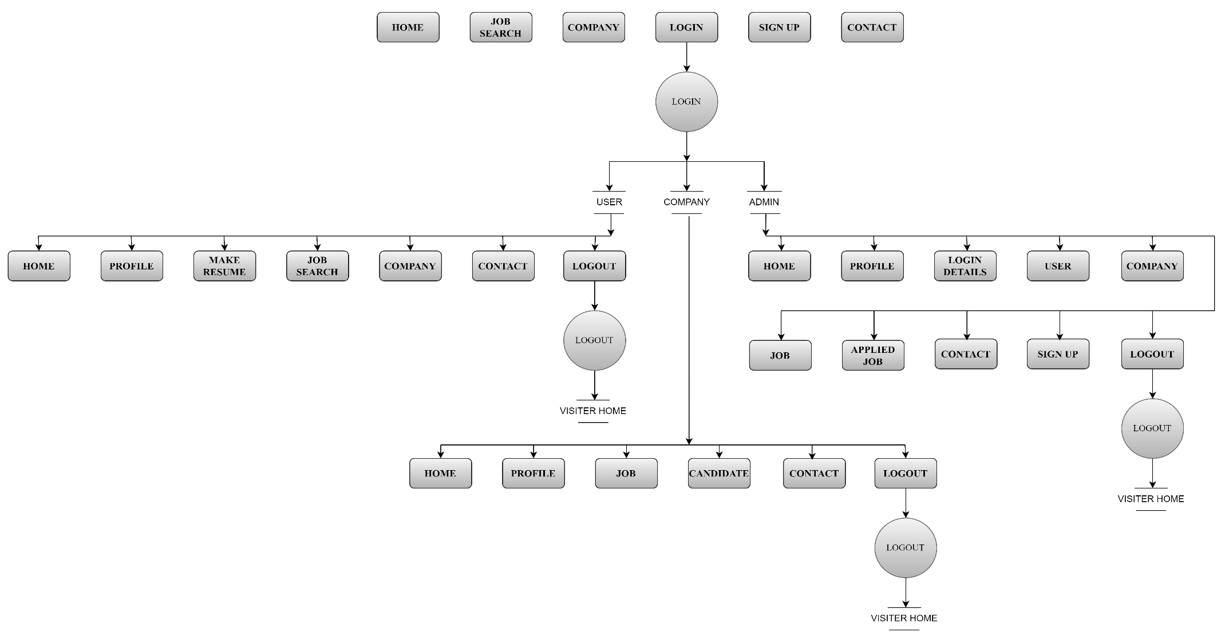
Data Flow Diagram

Slide 7
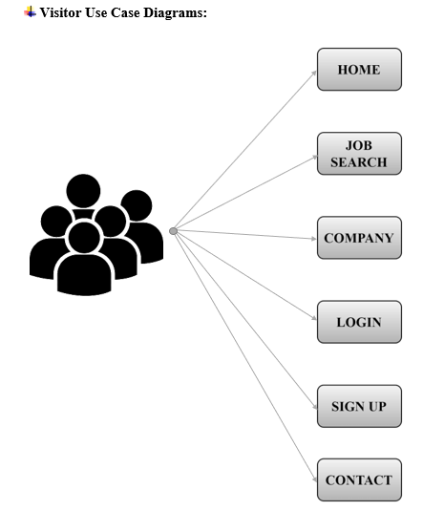
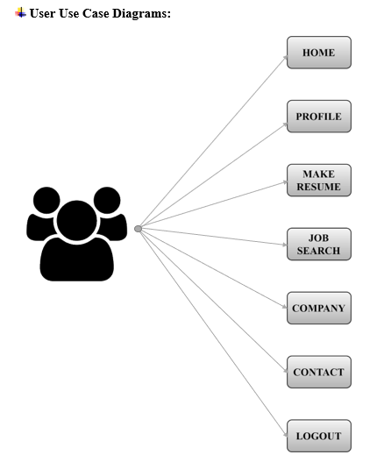
Use Case Diagrams

Slide 8
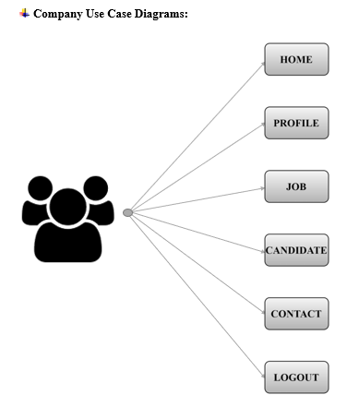
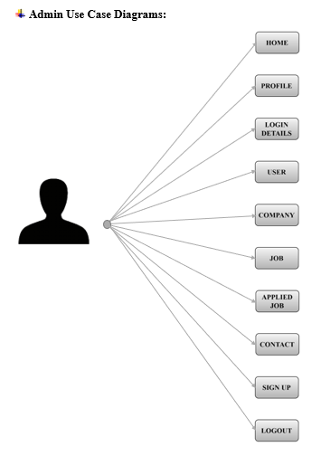
Use Case Diagrams

Slide 9
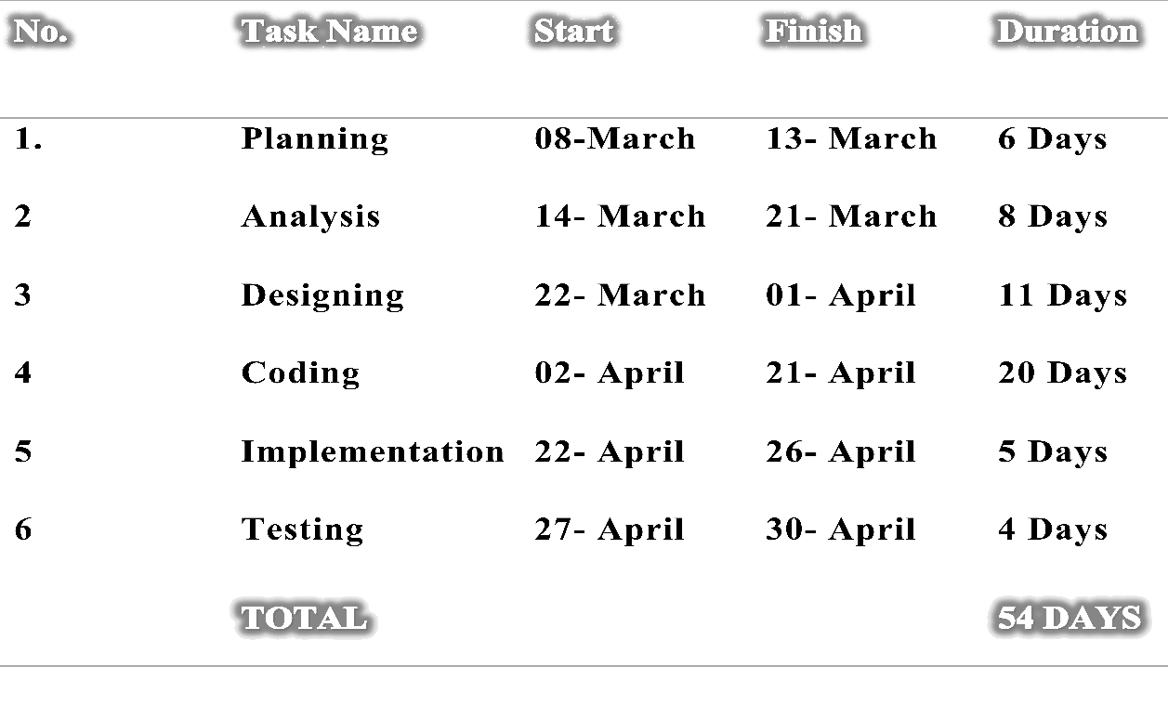
Project Planning Chart

Slide 10
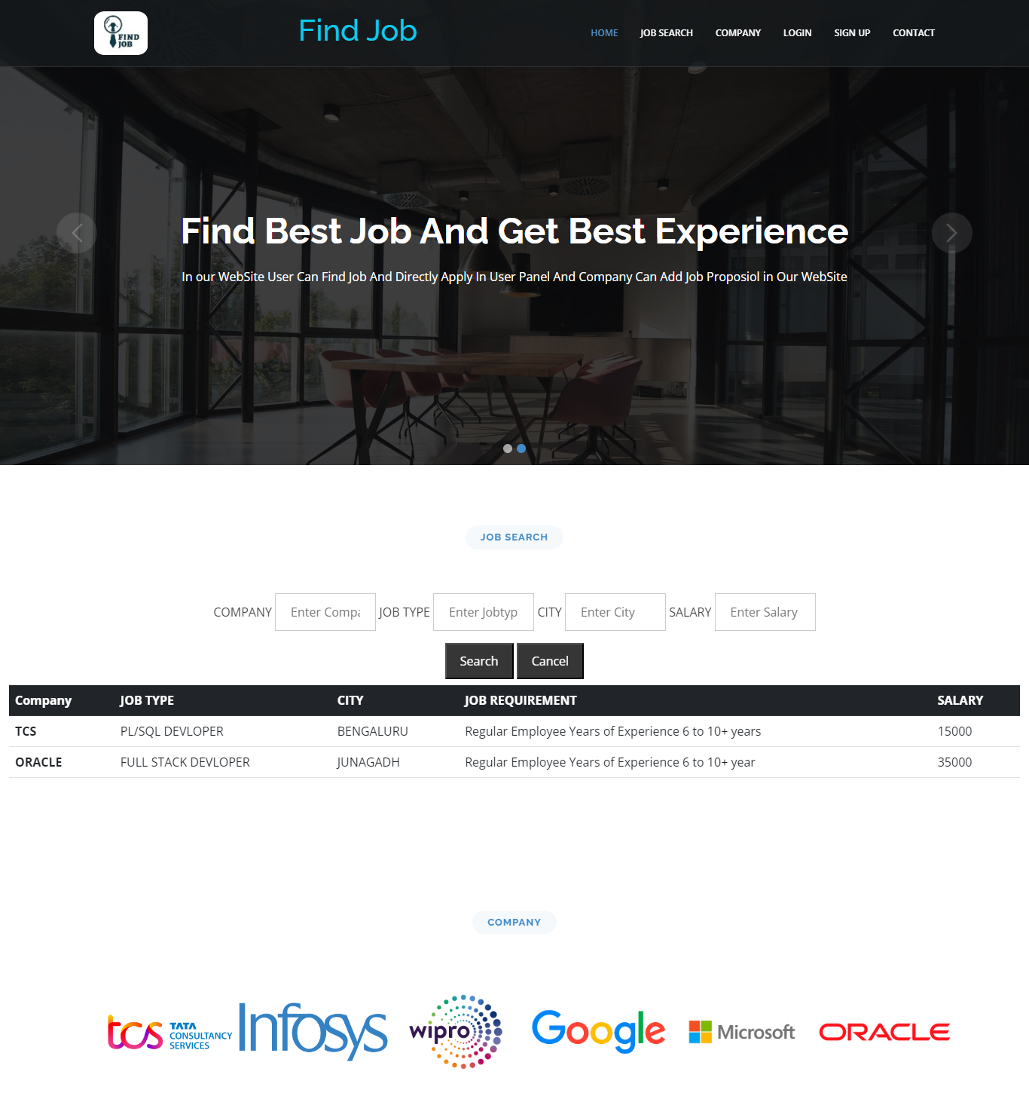
Project Images (UI)
Visi
tor
Side

Slide 11
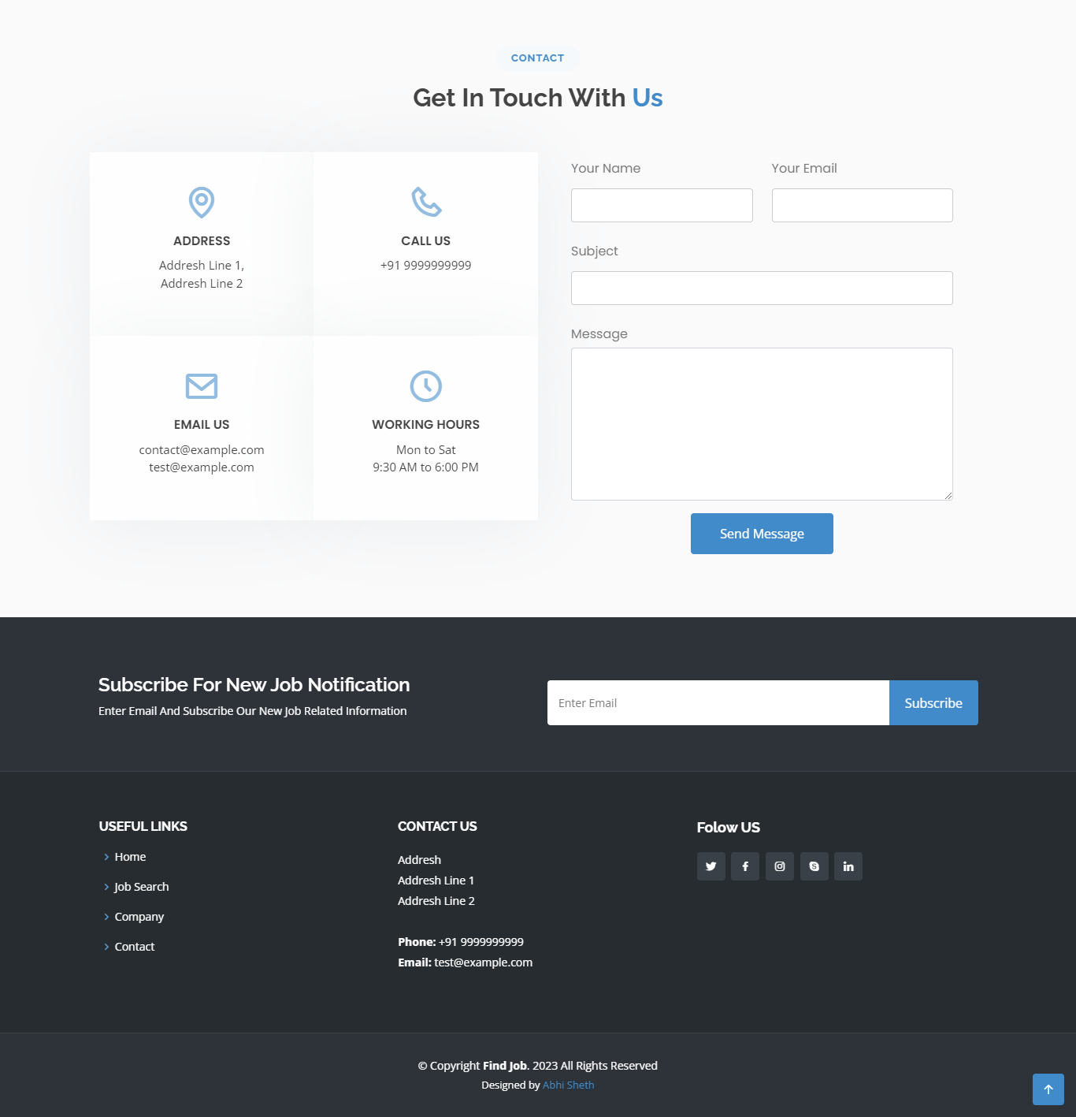

Slide 12
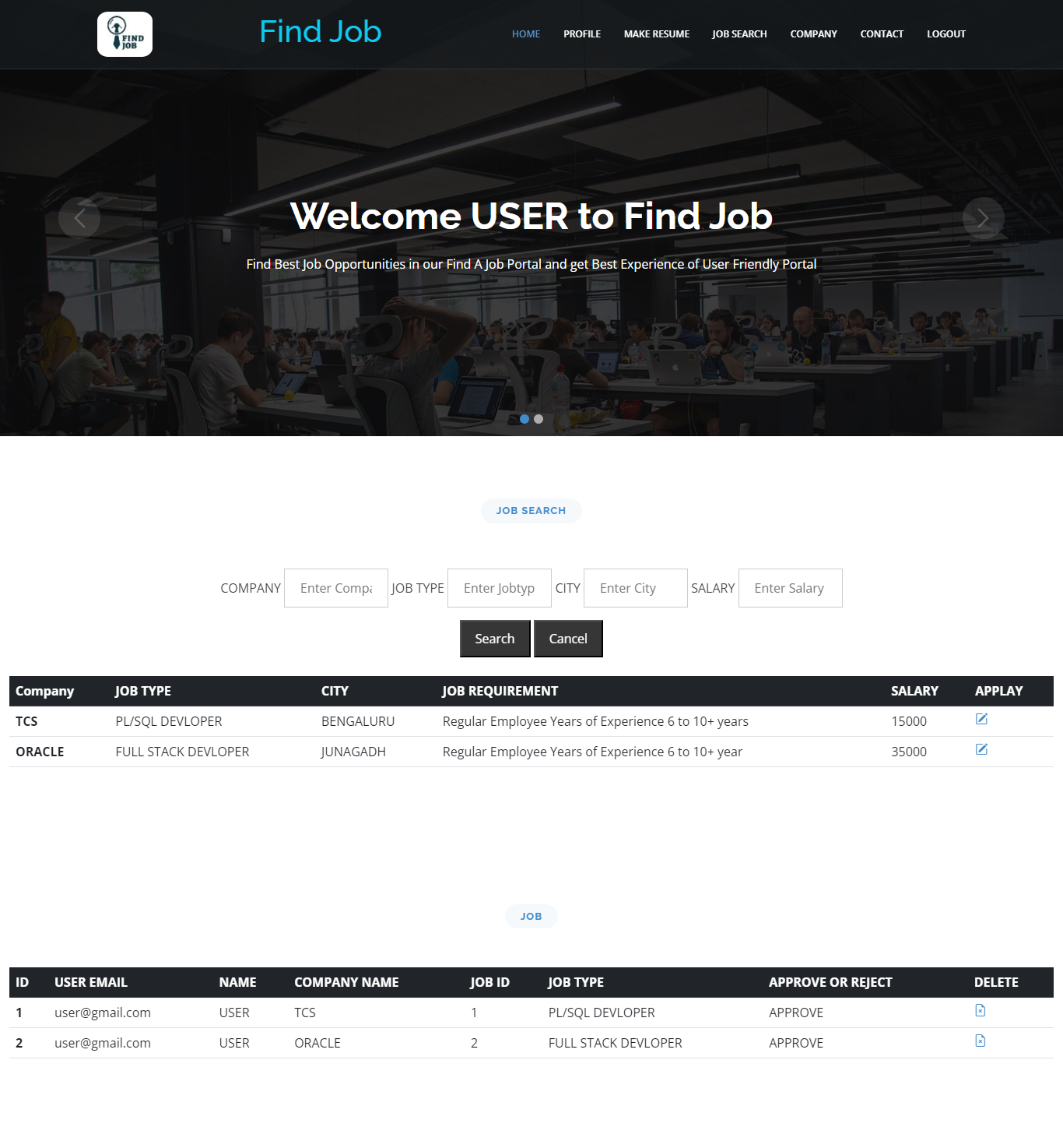
User
Side

Slide 13
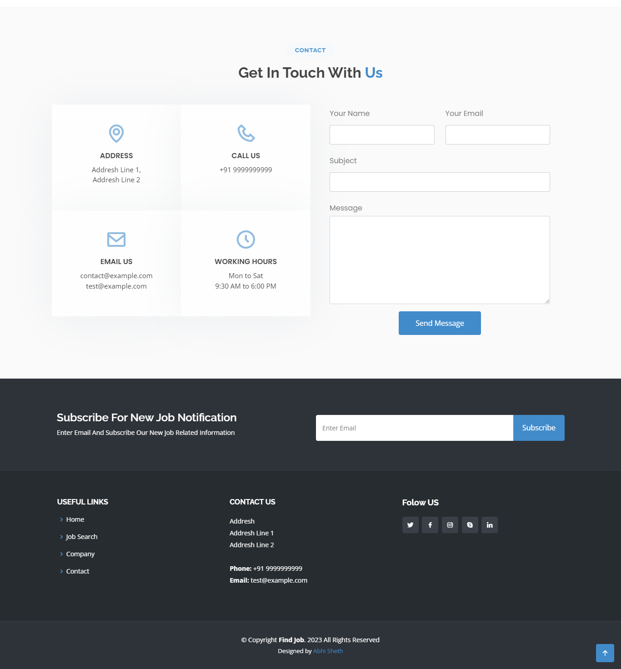

Slide 14
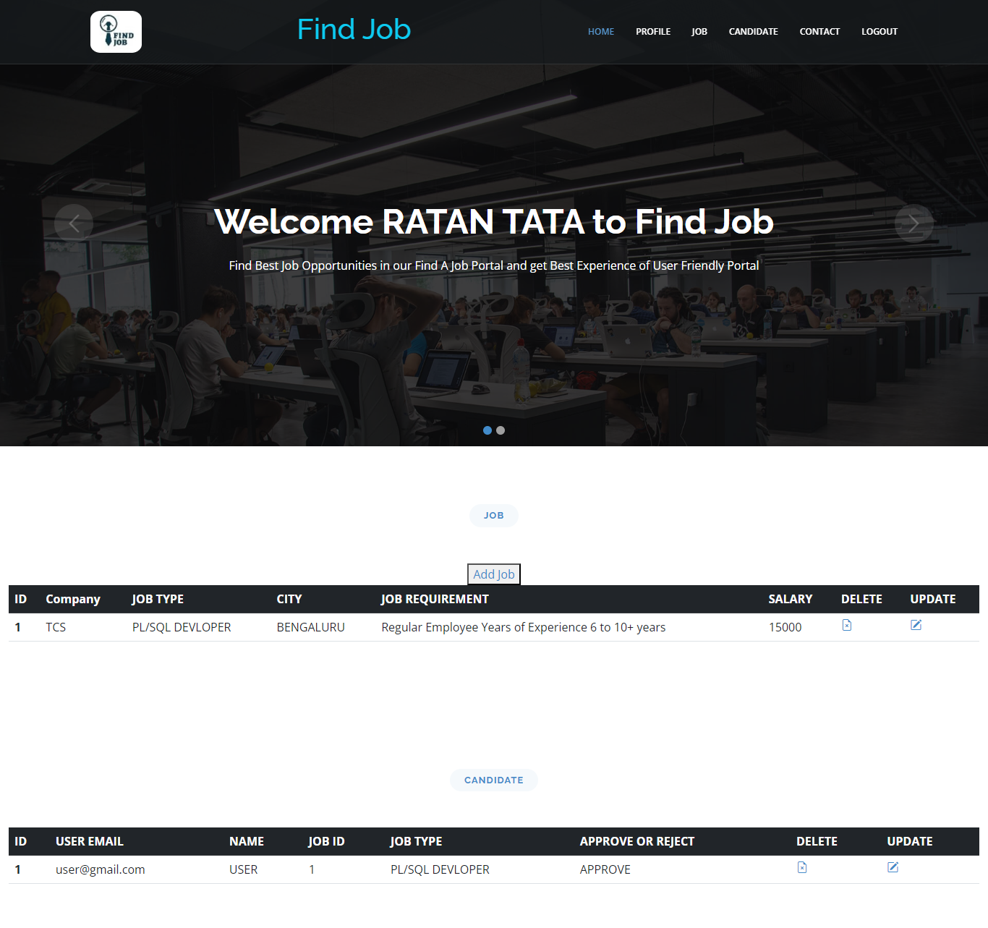
Company
S
i
de

Slide 15


Slide 16
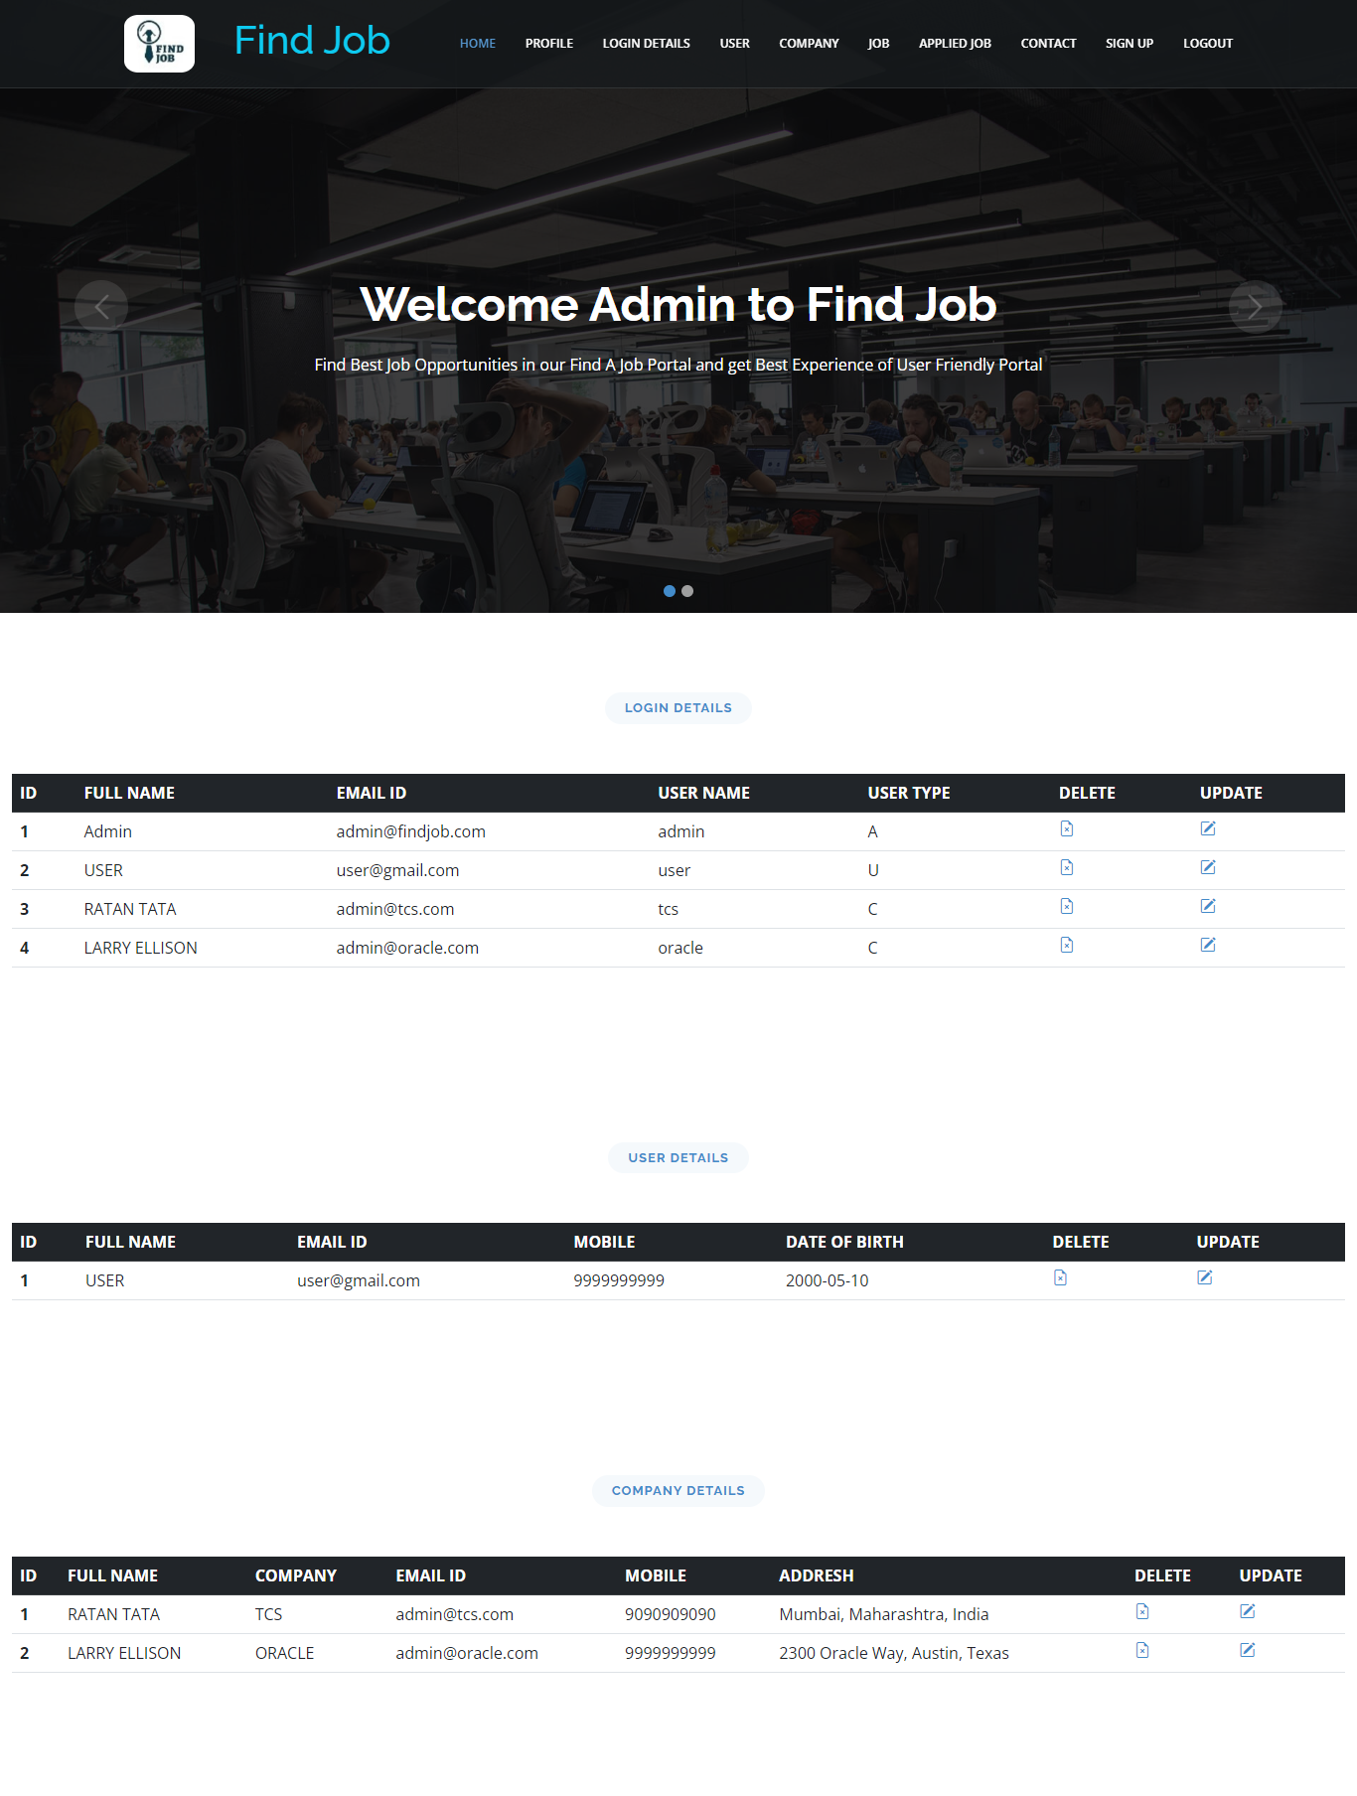
Admin
Side

Slide 17
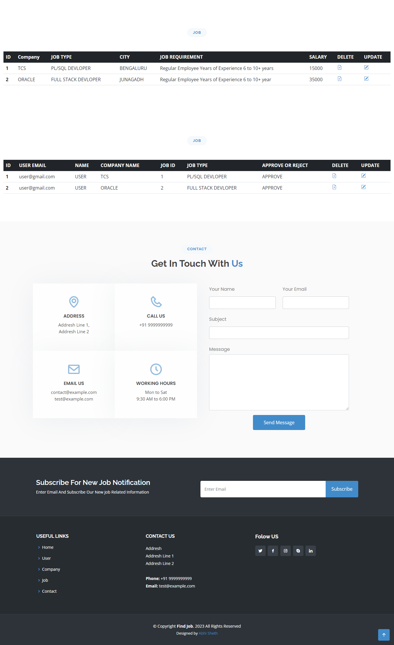

Slide 18
Coding
<?php
if (isset($_POST['ok'])) {
$cn = mysqli_connect("localhost", "root", "", "fj");
if ($cn) {
echo "";
} else {
die("Connaction Faild Because" . mysqli_connect_error());
}
$un = $_POST['un'];
$ps = $_POST['ps']; $rec = mysqli_query($cn, "SELECT * FROM user WHERE un='$un' AND ps='$ps'");
$res = mysqli_num_rows($rec);
$fe = mysqli_fetch_array($rec);
if ($res == 1) {
session_start();
$_SESSION['lo'] = 'lo';
if ($fe['uac'] === 'A') {
$_SESSION['adm'] = $fe['un'];
echo "<script>window.location.assign('admin.php');</script>";
}
if ($fe['uac'] === 'C') {
$_SESSION['com'] = $fe['un'];
echo "<script>window.location.assign('company.php');</script>";
}
if ($fe['uac'] === 'U') {
$_SESSION['usr'] = $fe['un'];
echo "<script>window.location.assign('user.php');</script>";
}
} else {
echo "<script> alert('Username or Password Not Valid');
window.location.assign('index.php');</script>";
}
}
?>

Slide 19
Future Enhancement
A good project is one which never stops developing according to the changing situations and technologies there is a lot of scope of future enhancements.
Online Payment.
User Search History.
Make Resume.
Notifications to users.
Alert Notification message to user on email or SMS.

Slide 20
Thank You

